Slide 1
Quantum Computation of Hubbard Model using IBM Q

Slide 2
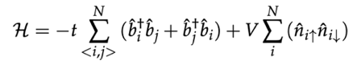
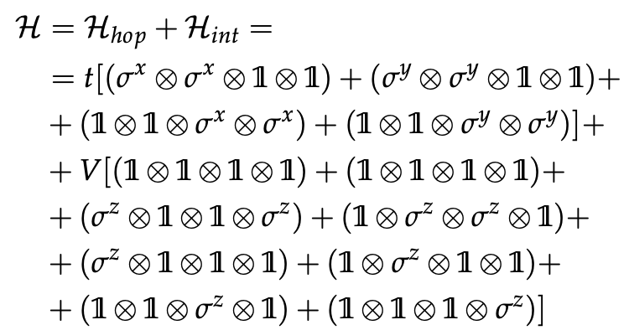
Problem mapping & Hamiltonian J-V transformed
Introduction
Problem mapping
Fermionic Hamiltonian
1
2
2
1
4
3
2
1
q0
q1
q2
q3
Spin Hamiltonian
hopping
interaction
qubit
mapping

Slide 3
Two sites Hubbard Model Time evolution

Slide 4
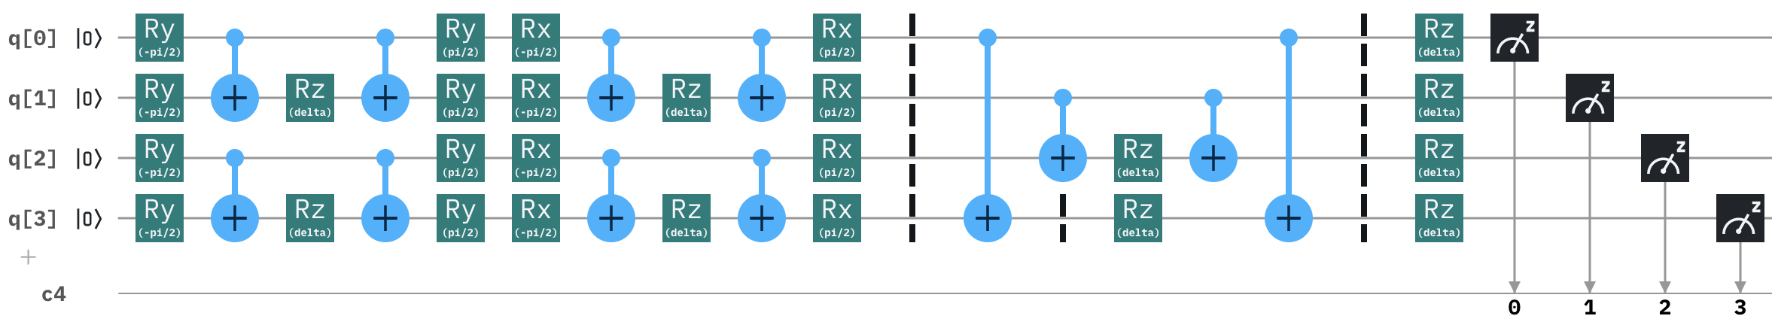
Quantum circuit
Time Evolution
Without 3-bodies components
By changing the mapping we can parallelize many CNOTs and reduce circuit complexity
Hopping term
Interaction term

Slide 5
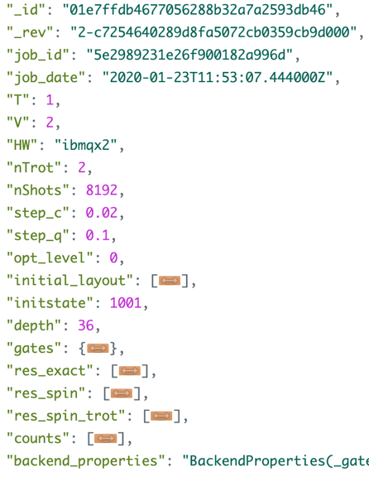
Data model
Time Evolution
Results are stored in a IBM Cloud Cloudant DB
DB data
Run parameters
Results
Calibration

Slide 6
Readout/Post selection
Time Evolution
Expectation value corrections: physical quantities conservations (number of particles: n_up, n_down; total spin)
consider feasible vs unfeasible states (feasible states within the current mapping: 0110, 0101, 1001, 1010)
Sum counts on feasible states (and unfeasible states) for each angle
Calculate ratio = counts_unfeasible/counts_feasible for each angle
Calculate average ratio across angles
Calculate average feasible shots across angles
Calculate bound = <feasible shots>/<ratio>
Use the correction factor bound to normalize observables (instead of total number of shots)
Used qubit vs processor topology
Option 1: set initial layout by choosing the qubits to be used
Option 2: let Qiskit decide the best qubits (optimization levels) considering calibration
Gates characterization
Rotations characterization: tilt angles between pi/100 and pi/1000

Slide 7
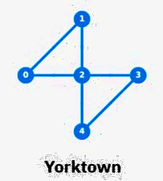
2 sites Hubbard – HW run results
Time Evolution
With error mitigation: physical quantities conservation
ibmq_5_yorktown - ibmqx2 v2.0.5
T: 1
V: 1
HW: ibmqx2
Date: 2020-03-26T13:53:44.573000Z
Trotter steps: 3
Optimization Level 0
Initial Layout [0, 1, 2, 3]
Circuit Depth: 55
Total Gates: {'u3': 66, 'cx': 60, 'measure': 4, 'barrier': 1}
DB Id: 63de949ef1814692dea40a82ab80bc2e
T: 1
V: 1
HW: ibmqx2
Date: 2020-03-31T12:14:48.610000Z
Trotter steps: 3
Optimization Level 3
Initial Layout [0, 1, 2, 3]
Circuit Depth: 58
Total Gates: {'u3': 66, 'cx': 63, 'measure': 4, 'barrier': 1}
DB Id: 59e8ff7e0f9f93c03fa5aa21cfae140e
T: 1
V: 2
HW: ibmqx2
Date: 2020-03-31T12:25:20.897000Z
Trotter steps: 3
Optimization Level 0
Initial Layout [0, 1, 2, 3]
Circuit Depth: 55
Total Gates: {'u3': 66, 'cx': 54, 'measure': 4, 'barrier': 1}
DB Id: 2457abde1283994d17d33ae6de063722
T: 1
V: 2
HW: ibmqx2
Date: 2020-03-31T12:38:17.567000Z
Trotter steps: 3
Optimization Level 3
Initial Layout [0, 1, 2, 3]
Circuit Depth: 58
Total Gates: {'u3': 66, 'cx': 60, 'measure': 4, 'barrier': 1}
DB Id: 9e62f3c2776a5524701e1f2a3af0a3d5
T: 2
V: 1
HW: ibmqx2
Date: 2020-04-01T10:56:10.943000Z
Trotter steps: 3
Optimization Level 0
Initial Layout [4, 3, 2, 0]
Circuit Depth: 55
Total Gates: {'u3': 66, 'cx': 57, 'measure': 4, 'barrier': 1}
DB Id: 4db69f24141982b7fa2a99d2cb1a7839
T: 2
V: 1
HW: ibmqx2
Date: 2020-03-31T12:59:08.664000Z
Trotter steps: 3
Optimization Level 3
Initial Layout [0, 1, 2, 3]
Circuit Depth: 58
Total Gates: {'u3': 66, 'cx': 60, 'measure': 4, 'barrier': 1}
DB Id: a241bd24e2a051d7c8c81db3b1382783

Slide 8
2 sites Hubbard – Noise models
Time Evolution
Real run
With correction
ibmq_5_yorktown - ibmqx2 v2.0.5
T: 1
V: 1
HW: ibmqx2
Trotter steps: 3
Optimization Level 0
Initial Layout [0, 1, 2, 3]
Circuit Depth: 55
Total Gates: {'u3': 66, 'cx': 57, 'measure': 4, 'barrier': 1}
DB Id: e98c001abf297086922375a87caa9e7a
Date: 2020-04-28T07:50:31.266000Z
Thermal Relaxation T1 & T2
All errors
Depolarizing
Readout error

Slide 9
2 sites Hubbard – Noise models
Time Evolution
Real run
With correction
ibmq_5_yorktown - ibmqx2 v2.0.5
T: 1
V: 2
HW: ibmqx2
Trotter steps: 3
Optimization Level 0
Initial Layout [0, 1, 2, 3]
Circuit Depth: 55
Total Gates: {'u3': 66, 'cx': 57, 'measure': 4, 'barrier': 1}
DB Id: f4cacf3c15e4c3e93b77b859948515d7
Date: 2020-04-29T14:30:51.848000Z
Thermal Relaxation T1 & T2
All errors
Depolarizing
Readout error

Slide 10
2 sites Hubbard – Noise models
Time Evolution
Real run
With correction
ibmq_5_yorktown - ibmqx2 v2.0.5
T: 2
V: 1
HW: ibmqx2
Trotter steps: 3
Optimization Level 0
Initial Layout [0, 1, 2, 3]
Circuit Depth: 55
Total Gates: {'u3': 66, 'cx': 57, 'measure': 4, 'barrier': 1}
DB Id: bf3e90b742a947d25de112706676841b
Date: 2020-04-29T14:57:46.757000Z
Thermal Relaxation T1 & T2
All errors
Depolarizing
Readout error

Slide 11
Two sites Hubbard Model Ground State

Slide 12
Ground State calculation with VQE
Ground State
Need to find minimum energy varying Hamiltoniam parameters T and V
Extraction of linear combination parameters to express ground state related to minimum energy
Qiskit Aqua VQE
Spin Hamiltonian from J-W transformation
VQE Parameters
Optimizer: Qiskit optimizer (COBYLA, ADAM, …)
Variational Form: Qiskit RY, RYRZ
Depth: number of iteration of Variational Form
VQE calculation
Use all combinations of VQE Parameters to get the best Optimizer, Variational Form and Depth
Plots: Minimum Energy – Ratio (T/V)

Slide 13
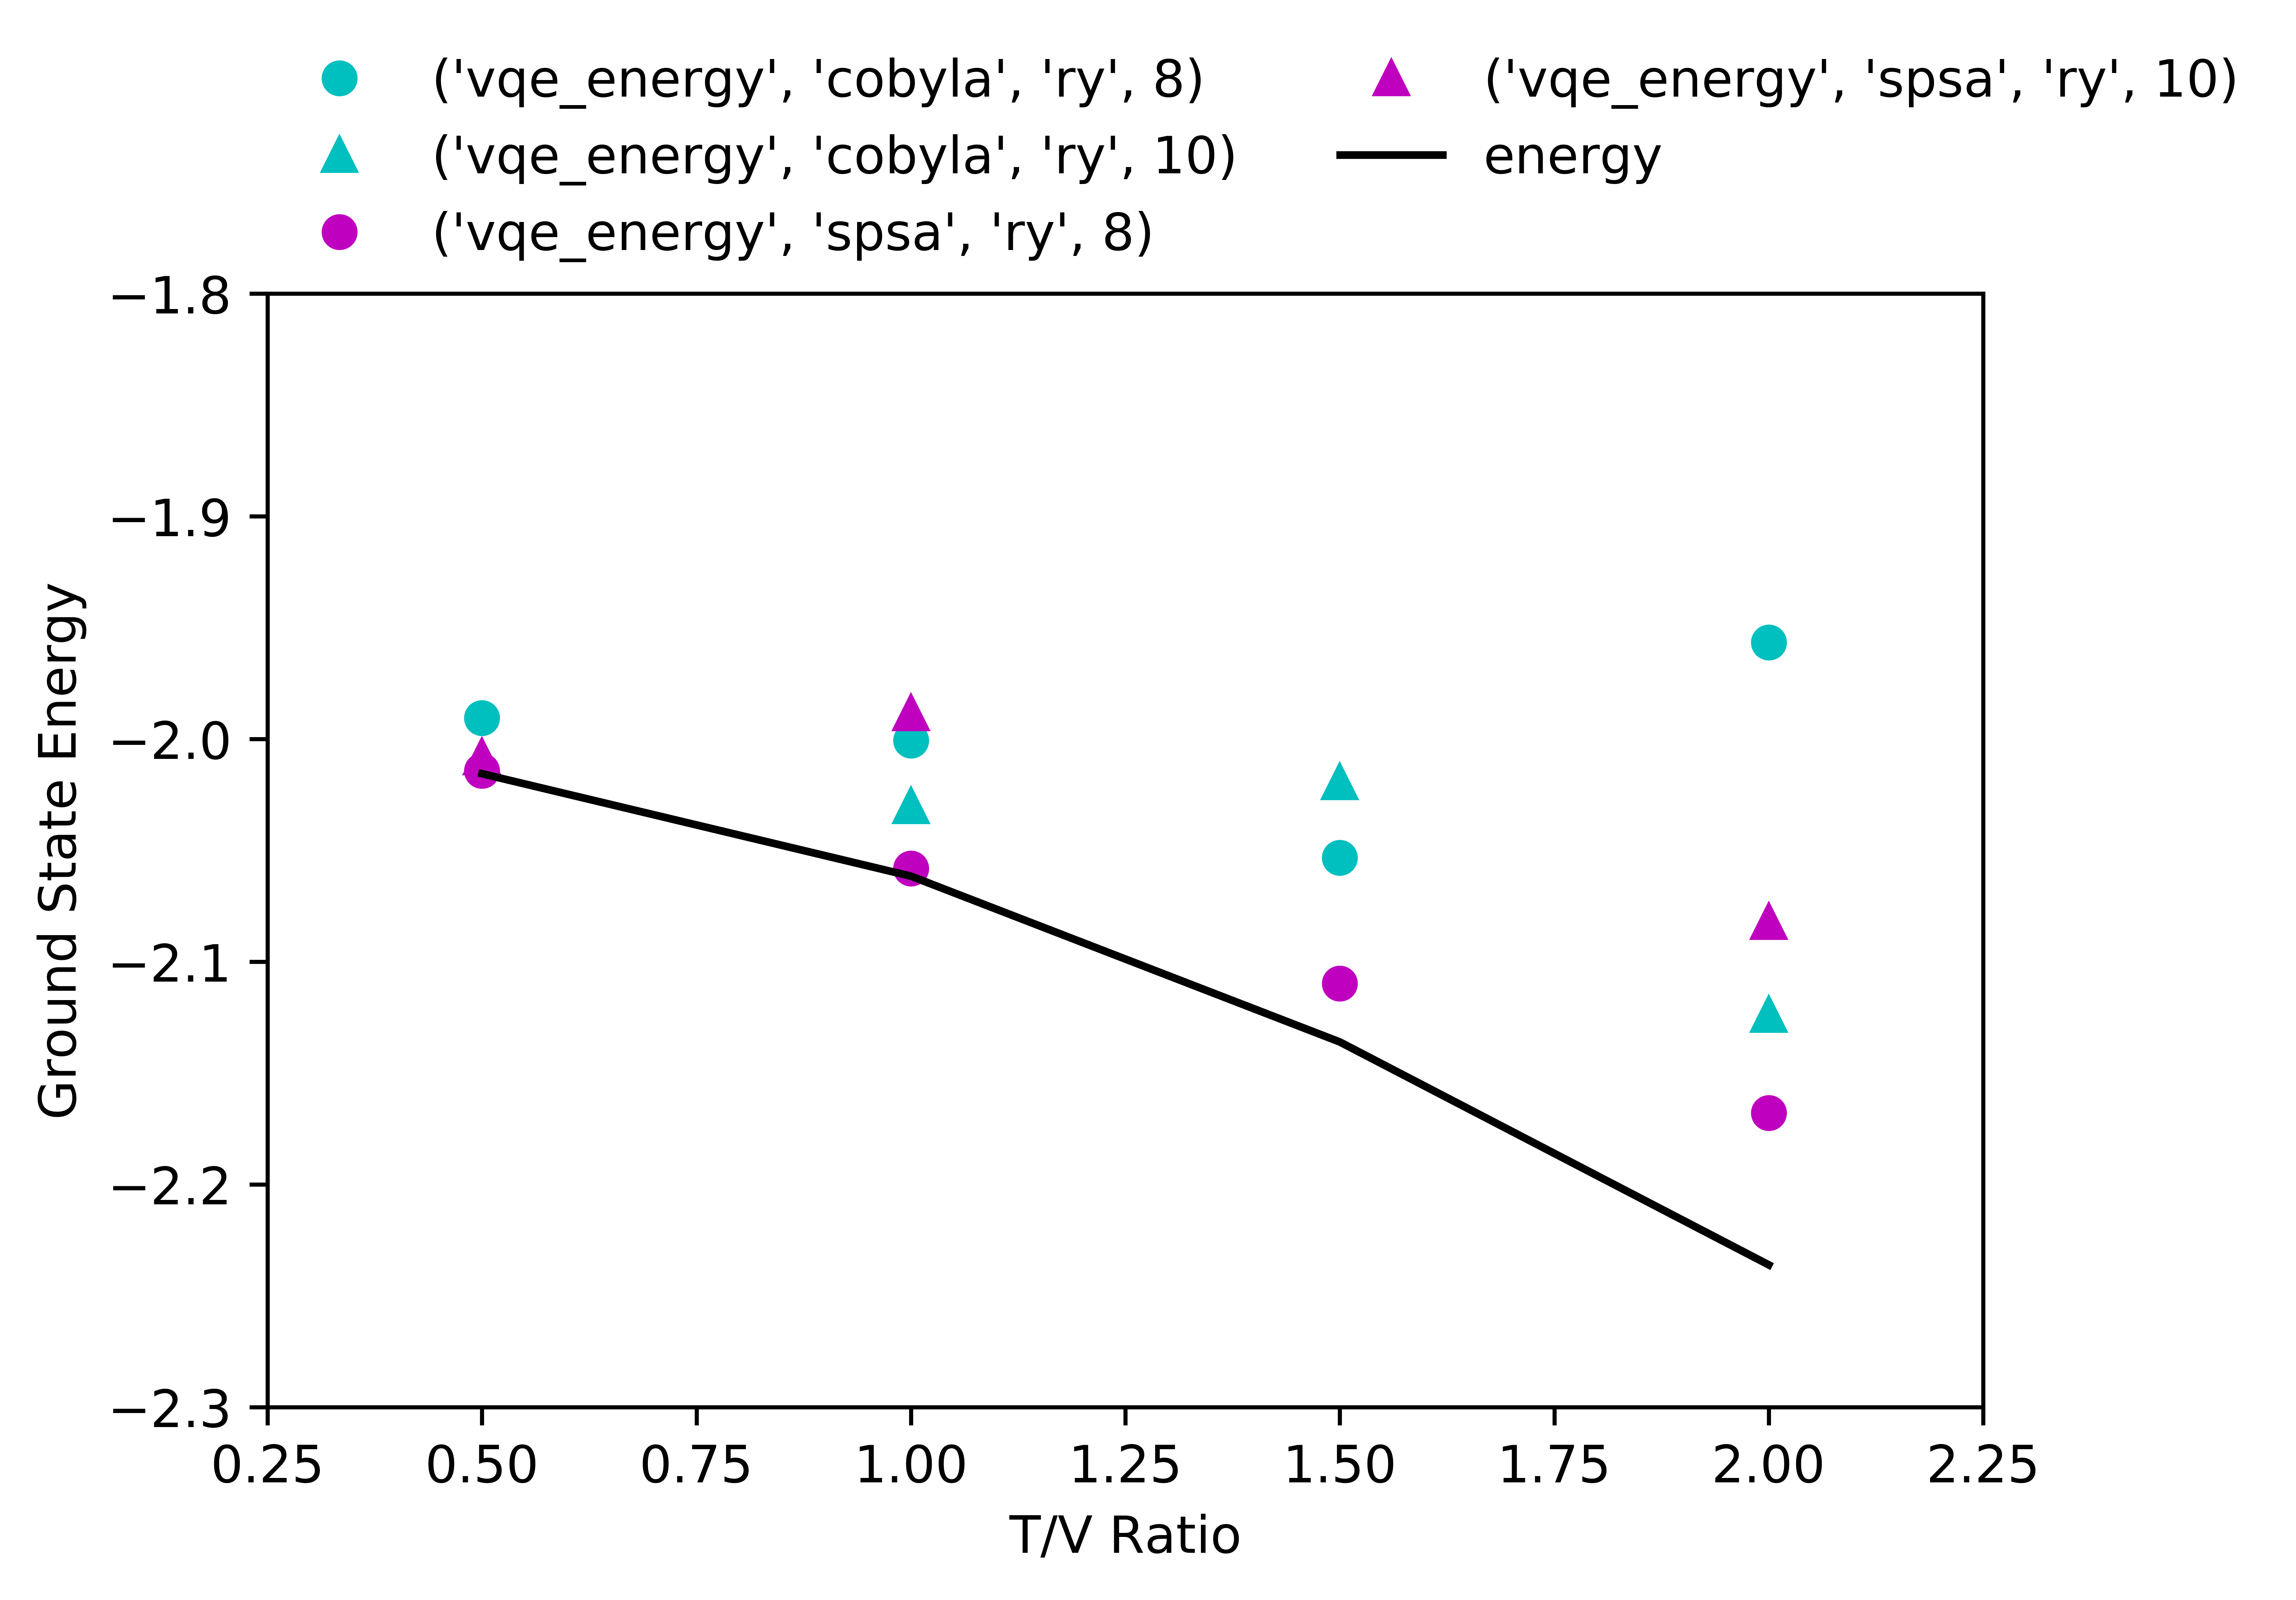
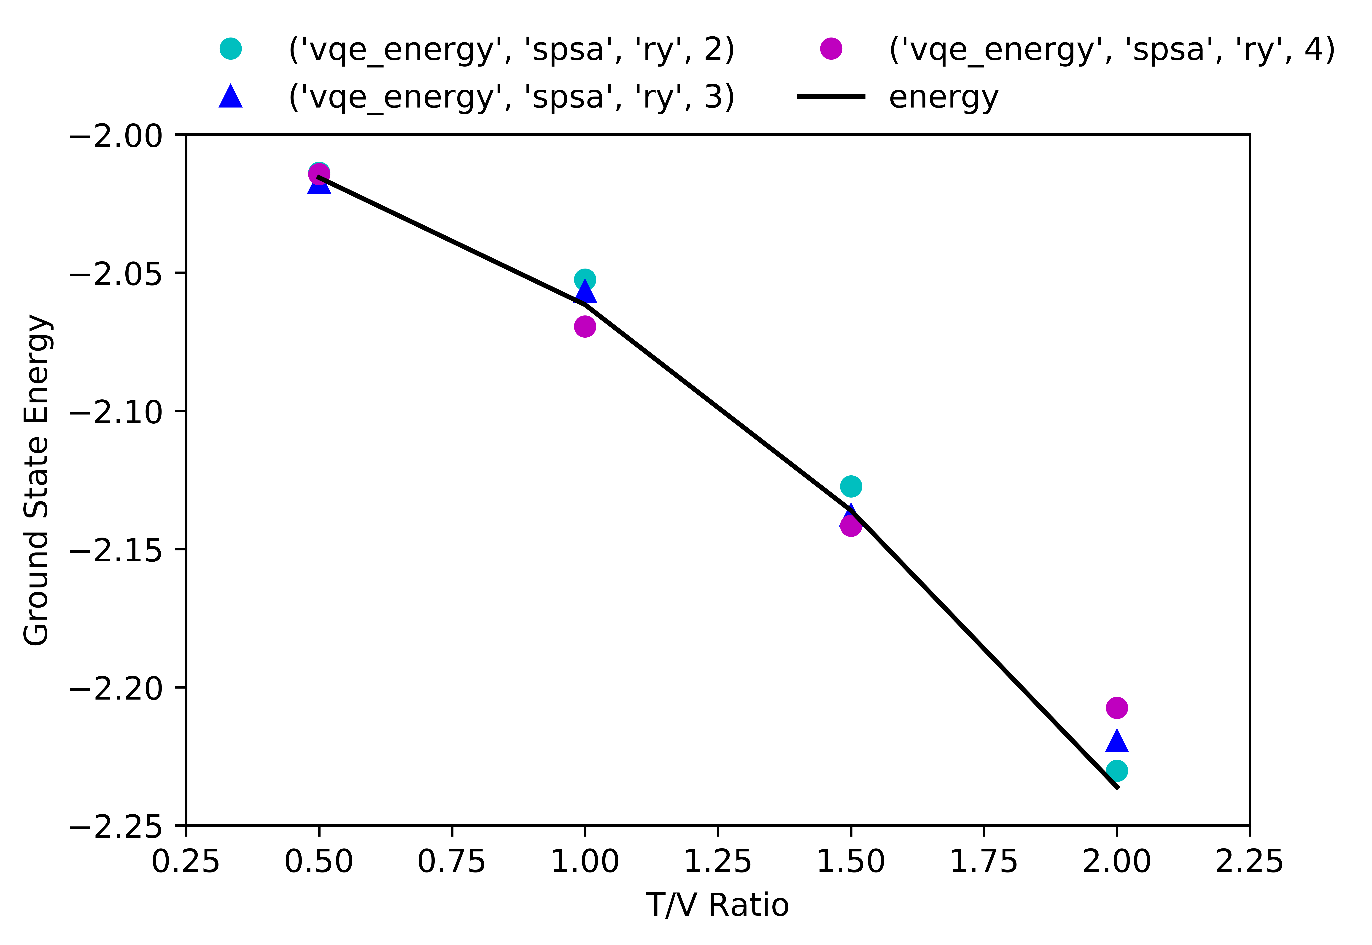
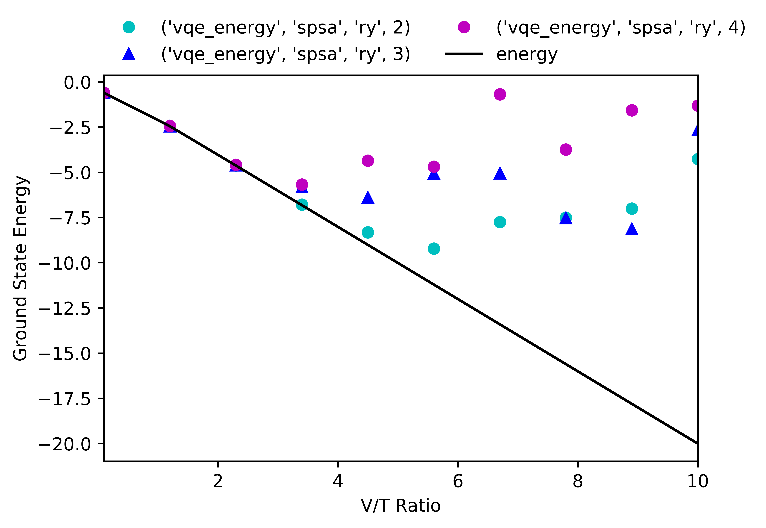
VQE results: minimum energy vs T/V
Ground State
d5988ccbf814b57967f1f5e2a46c21dd
08294ca1529aefb72aa0d4dda593c960
ce133cc3228c48c785248c35ee6af362
ce133cc3228c48c785248c35ee6e9eee

Slide 14
2 sites Hubbard HW run: outcomes
Quantum HW runs
1) Quantum chip
The best quantum chip to be used is ibmq_5_yorktown - ibmqx2 v2.0.5 due to it’s topology matching quite well with needed CX gates.
2) Run parameters
Trotter steps: in range T ~ V, the number of nTrots increases circuit’s depth and gates.
Transpiling: optimization level 3 increases circuit’s depth and CX number. Best results are obtained with manual qubits selection (initial layout, with optimization level 0)
3) Correction parameters
Physical quantities conservation:
number of particles n_up and n_down
total spin
Thus the total number of particles is conserved.
4) Aer simulation with noise
Experimental behaviour found combining all errors

Slide 16
Backup

Slide 17
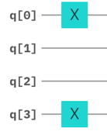
Spin hamiltonian to quantum circuit
Quantum circuit implementation
Building blocks
Initial state 1001
arXiv:1907.03505v1
arXiv:1907.03505v1
ZZ
ZZZ
XZX
arXiv:1907.03505v1
arXiv:1907.03505v1
XX
YY
YZY

Slide 18
Optimizations required Results
Quantum circuit optimization
Avoiding 3-bodies components
Three-body terms in the hopping term do not carry any information: sigma_z can be replaced with identity in hopping term. Three-body terms become important when considering more than 2 sites (multiple hopping)
2° order Suzuki-Trotter decomposition
Hopping term works well with 1 Trotter step: interaction term carries on differences and need to use more Trotter steps. While only a few Trotter steps can be implemented (cx gates less than 50), we need to increase performances by adding a Trotter step only to the term with less cx gates (interaction term)
Same behaviour for 2 sites Hubbard Model, less gates
This cannot be used on a 3 sites frustrated triangle Hubbar Model
No changes in performances

Slide 19
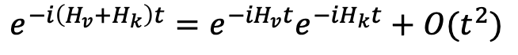
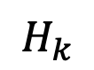
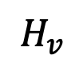
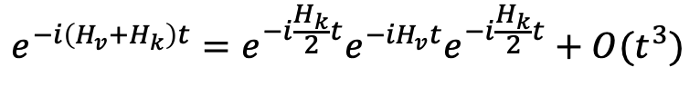
2° order Suzuki-Trotter decomposition
Quantum circuit optimization
Mapping 1
OPTIMIZED (with 2° order S-T) on Hk
$$e^{−i\left(H_{v}+H_{k}\right)t}=e^{−{iH}_{v}t}e^{−{iH}_{k}t}+O(t^{2})$$
Initial state 1100, T=1, V=1, n1, nT=2
$$H_{v}$$
carries 4 CNOT (2 in parallel)
$$H_{k}$$
(optimized) carries 8 CNOT (in series)
Seems that at low nTrot the 2° order S-T fails sooner
Gain in performance at high times
No significant gain at low-middle times
$$e^{−i\left(H_{v}+H_{k}\right)t}=e^{−i\frac{H_{k}}{2}t}e^{−{iH}_{v}t}e^{−i\frac{H_{k}}{2}t}+O(t^{3})$$
Initial state 1100, T=1, V=1, n1, nT=3

Slide 20
Fermionic exact vs spin exact
Benchmark
Mapping 1
Initial state 1100, T=1, V=0, n1
Initial state 1100, T=1, V=1, n1
Initial state 1100, T=1, V=2, n1
Initial state 1001, T=1, V=0, n1
Initial state 1001, T=1, V=1, n1
Initial state 1001, T=1, V=2, n1

Slide 21
Spin exact vs trotter
Benchmark
Mapping 1
Initial state 1100, T=1, V=0, n1, nT=3
Initial state 1100, T=1, V=1, n1, nT=3
Initial state 1100, T=1, V=2, n1, nT=3
Initial state 1100, T=1, V=0, n1, nT=5
Initial state 1100, T=1, V=1, n1, nT=5
Initial state 1100, T=1, V=2, n1, nT=5

Slide 22
Spin exact vs trotter vs quantum simulated
Benchmark
Initial state 1001, T=1, V=0, n1, nT=1
Initial state 1001, T=2, V=1, n1, nT=3
Initial state 1001, T=4, V=1, n1, nT=5
('u3', 30), ('cx', 17), ('measure', 1)
('u3', 90), ('cx', 51), ('measure', 1)
('u3', 150), ('cx', 85), ('measure', 1)
Initial state 1001, T=1, V=2, n1, nT=3
Initial state 1001, T=1, V=2, n1, nT=5
Initial state 1001, T=1, V=4, n1, nT=5
('u3', 90), ('cx', 51), ('measure', 1)
('u3', 150), ('cx', 85), ('measure', 1)
('u3', 150), ('cx', 85), ('measure', 1)

Slide 23
Used qubit vs processor topology
Quantum circuit optimization
Qubit mapping
The «compiler» uses the qubit allowed by the processor topology, adding several SWAP gates. Probably this feature can be disabled in order to try to select manually the right qubits avoiding the SWAP gates.
If qubits are not connected, add SWAP gates. Possibility to map manually
Trivial layout: Map virtual qubits to the same numbered physical qubit on the device, i.e. [0,1,2,3,4] -> [0,1,2,3,4] (default in optimization_level=0)
Dense layout: Find the sub-graph of the device with same number of qubits as the circuit with the greatest connectivity (default in optimization_level=1)
Noise adaptive layout: Uses the noise properties of the device, in concert with the circuit properties, to generate the layout with the best noise properties (default in optimization_level=2 and optimization_level=3)
The choice of initial layout is extremely important when:
1) Computing the number of SWAP operations needed to map the input circuit onto the device topology
2) Taking into account the noise properties of the device
https://github.com/Qiskit/qiskit-iqx-tutorials/blob/master/qiskit/fundamentals/5_using_the_transpiler.ipynb

